Slide 1
HTML
continued

Slide 2
Icebreaker exercise
try to spot the deliberate mistake in the following markup
<HTML>
<HEAD>
<TITLE>
HTML Table Design
</HEAD>
</TITLE>
<BODY>
</BODY >
</HTML >

Slide 3
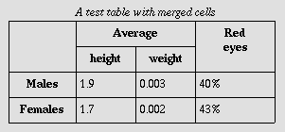
Icebreaker exercise
Write the markup for the table below

Slide 4
Solution
<table border="1“>
<caption><em>a test table with merged cells</em></caption>
<tr>
<th rowspan="2"></th>
<th colspan="2">average</th>
<th rowspan="2">red eyes</th>
</tr>
<tr>
<th>height</th>
<th>weight</th>
</tr>
<tr>
<th>males </th>
<td>1.9 </td>
<td>0.003 </td>
<td>40% </td>
</tr>
<tr>
<th>females </th>
<td>1.7 </td>
<td>0.002 </td>
<td>43% </td>
</tr>
</table>

Slide 5
HTML Block and Inline elements
HTML has 2 main types of elements
Block elements
Inline elements
Block elements are meant to structure the main parts of your page, by dividing your content in coherent blocks.
While paragraphs and lists are meant to identify whole blocks of text, we sometimes want to provide meaning to a word (or a few words) within a text.
Inline elements are meant to differentiate part of a text, to give it a particular function or meaning.

Slide 6
Block Level Elements
Block level elements take up as much space as possible by default. Each block level element will start a new line on the page, stacking vertically down the page.
The p element is an example of a block level element. Each new paragraph tag will appear on its own line vertically.
Paragraphs with longer content will stretch all the way to the edge of the page.
Examples of block level elements:
<p>
<ol>, <ul>, <dl>
All headings

Slide 7
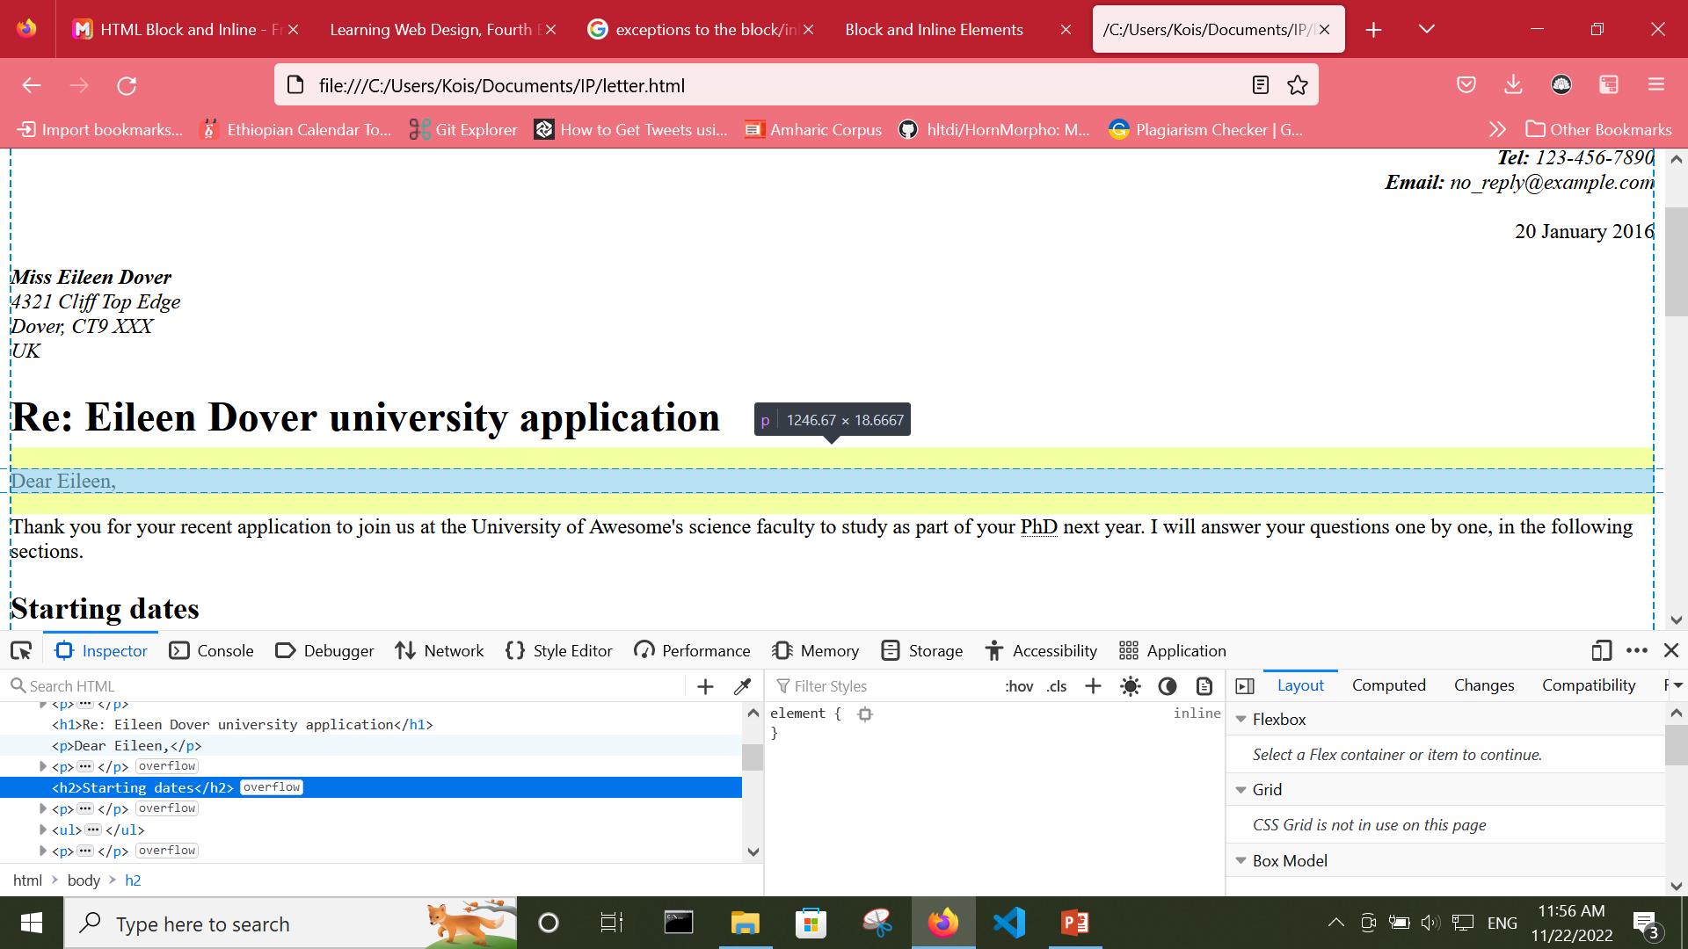
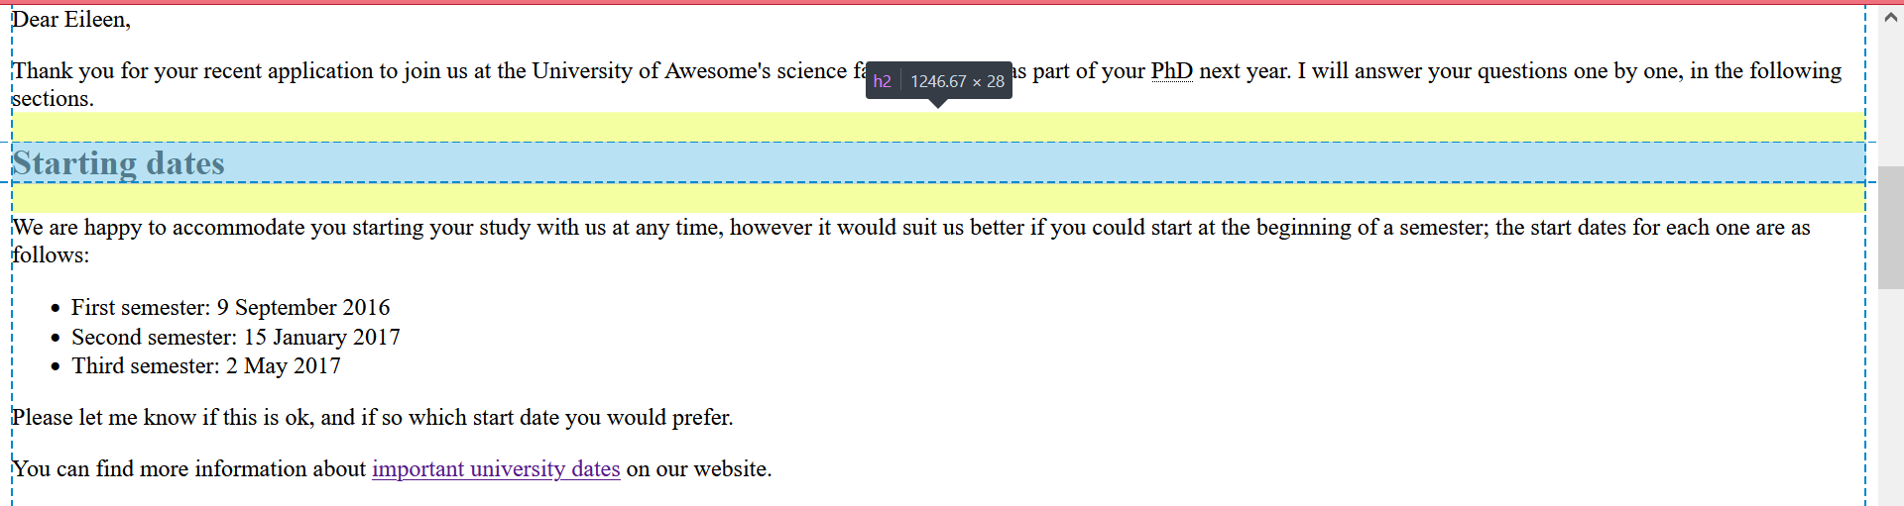
Block Level Elements example

Slide 8
Inline elements
Inline elements display in a line. They do not force the text after them to a new line.
An anchor (or link) is an example of an inline element. You can put several links in a row, and they will display in a line.
Examples of inline elements:
<a>
<strong>, <em>, <b>, <i>, <q>, <cite>
<span>
Inline elements cannot contain block level elements
For example, you cannot wrap an <em> around two paragraphs

Slide 9
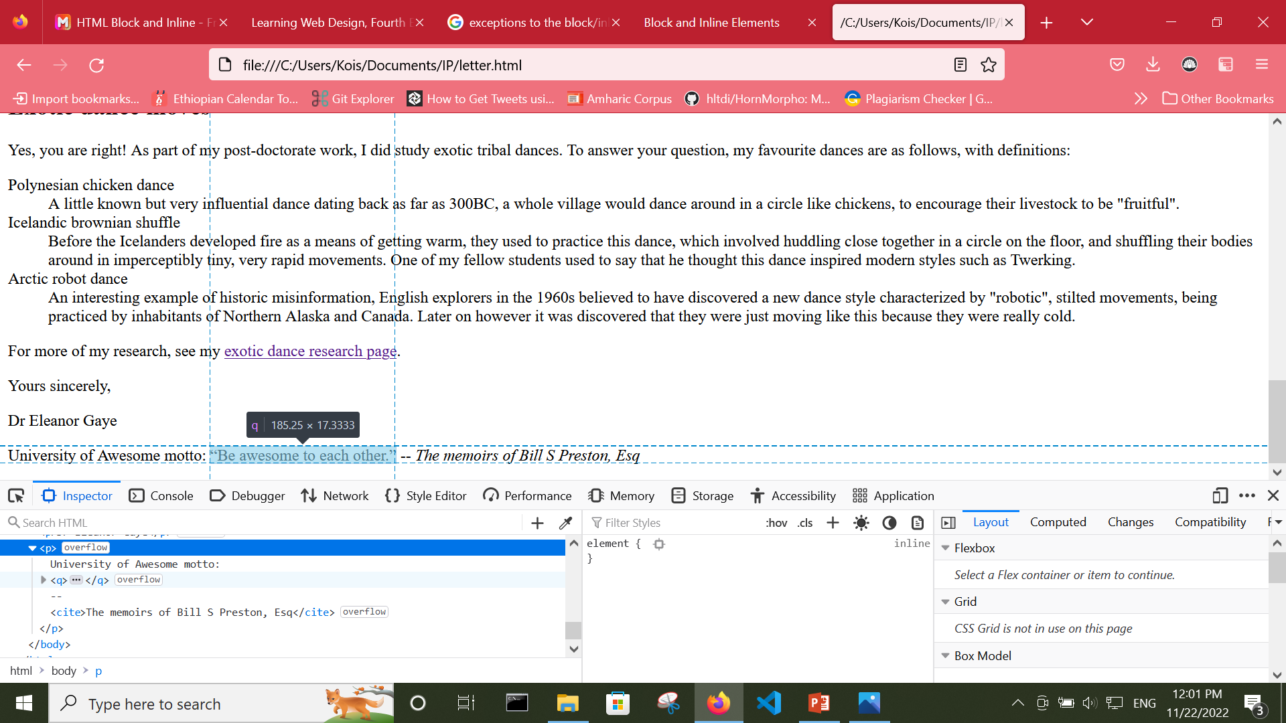
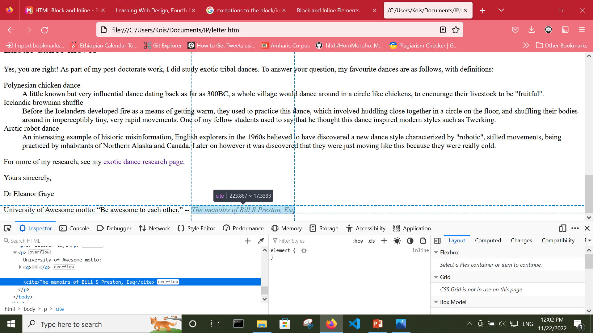
Inline Level Elements example

Slide 10
Takeaway questions
What is the difference between block and inline elements?
Give examples of block elements
Give examples of inline elements

Slide 11
HTML Forms
It didn’t take long for the web to shift from a network of pages to read to a place where you go to get things done. Such as, making purchases, booking plane tickets, signing petitions, posting a tweet, etc…
Web forms handle all such interactions.
An HTML form is used to collect user input. The user input is most often sent to a server for processing.
Forms are made up of buttons, input fields, and drop-down menus (collectively known as form controls) used to collect information from users.
Forms may also contain texts and other elements.

Slide 12
The Form Element <form> </form>
Forms are added to web pages with the form tag.
The form element is a container for all the content of the form, including some number of form controls, such as text-entry fields and buttons.
It may also contain elements like h1, p, and lists.
However, a form may not contain another form element.

Slide 13
Example
<form action="/mailinglist.php" method="POST">
<fieldset>
<legend>Join our email list</legend>
<p>Get news about the band such as tour dates and special MP3 releases sent to your own in-box.</p>
<label for="firstlast">Name:</label>
<input type="text" name="fullname" id="firstlast">
<label for="email">Email:</label>
<input type="text" name="email" id="email">
<input type="submit" value="Submit">
</fieldset>
</form>
Notes:
The fieldset, legend, and label elements used in the example improve accessibility. We’ll cover them in detail later.

Slide 14
Takeaway questions
List examples of the type of interactions you can implement using HTML forms
What are the sort of elements that an HTML form might contain?
Write an HTML code with simple form with two input fields for a firstname and a lastname with a submit button

Slide 15
The Form Element cont’d
The form element has some attributes that are necessary for interacting with the form processing program on the server
The action attribute provides the location (URL) of the code or script that will be used to process the form.
The method attribute specifies how the information should be sent to the server.
There are only two methods for sending data to the server: POST or GET,
With the GET method, the form data gets appended right onto the URL sent to the server.
With POST, the browser sends a separate server request containing some special headers followed by the data. In theory, only the server sees the content of this request

Slide 16
When to use GET and POST
GET
Appends form-data into the URL in name/value pairs
The length of a URL is limited (about 3000 characters)
Never use GET to send sensitive data! (will be visible in the URL)
Useful for form submissions where a user wants to bookmark the result
GET is better for non-secure data, like query strings in Google
POST
POST has no size limitations, and can be used to send large amounts of data.
Form submissions with POST cannot be bookmarked

Slide 17
Takeaway questions
Which form attribute provides the URL of the code that will be used to process the form?
Which form attribute specifies how the information gathered on a form should be sent to a server?
Create an HTML form element that uses the GET method to submit data to the program /createlist.php.

Slide 18
Form Control
There are markups that add form controls to pages; elements used to create the following:
Text-entry controls
Submit and reset buttons
Radio and checkbox buttons
Pull-down and scrolling menus
File selection and upload control
Hidden controls
Dates and times
Numerical controls
Color picker control

Slide 19
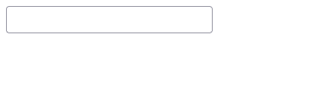
<input>
The majority of controls added to a form are done via the input element.
The functionality and appearance of the input element changes based on the value of the type attribute in the tag.
The default input type is the text-entry field for entering a single word or line of text,
i.e., it is what you’ll get if you don’t include the type attribute.
In HTML5, there are twenty-two types of input controls.
Notes:
The specific rendering style of form controls varies by operating system and browser version.

Slide 20
Attributes for the <input> element
The <input> element is so powerful because of its attributes; the type attribute, mentioned in the previous slide, being the most important.
The following are some of the attributes for the input element
The name attribute is required for indicating the variable name. It is the name of the form control. Submitted with the form as part of a name/value pair
The value attribute is the initial value of the control. The value of the value attribute gets submitted to the server
The maxlength attribute specifies the maximum number of characters
The minlength attribute specifies the minimum number of characters
https://developer.mozilla.org/en-US/docs/Web/HTML/Element/input#attributes

Slide 21
Multiline text-entry field
The <textarea> element defines a multi-line input field (a text area):
The rows attribute specifies the visible number of lines in a text area.
The cols attribute specifies the visible width of a text area.
The maxlength attribute (new in HTML5) sets a limit on the number of characters that can by typed into the field
Example,
<textarea name=“comment" rows="5" cols="50">The band is totally awesome!</textarea

Slide 22
Specialized Text-Entry Fields
Password: A single-line text field whose value is obscured. Will alert user if site is not secure.
<input type="password">
Email: A field for editing an email address. Looks like a text input, but has validation parameters and relevant keyboard in supporting browsers and devices with dynamic keyboards.
<input type="email">
Tel: A control for entering a telephone number. Displays a telephone keypad in some devices with dynamic keypads.
<input type="tel">
Notes:
Note: These input types use the same attributes as the generic text input type (name, maxlength, minlength, size, and value), as well as a number of other attributes

Slide 23
Specialized Text-Entry Fields
url: A field for entering a URL. Looks like a text input, but has validation parameters and relevant keyboard in supporting browsers and devices with dynamic keyboards.
<input type=“url">
Search: A single-line text field for entering search strings. Line-breaks are automatically removed from the input value. Displays a search icon instead of enter key on some devices with dynamic keypads.
<input type="search">

Slide 24
submit and reset buttons
When clicked or tapped, the submit button immediately sends the collected form data to the server for processing.
A reset button returns the form controls to the state they were in when the form initially loaded. In other words, resetting the form doesn’t simply clear all the fields.
You can change the text on the button using the value attribute
<input type="reset" value="Start over">

Slide 25
submit and reset buttons
Both submit and reset buttons are added via the input element.
<input type="submit">
When clicked, the submit button immediately sends the collected form data to the server for processing.
By default, the submit button displays with the label “Submit”
<input type="reset">
A reset button returns the form controls to the state they were in when the form initially loaded.
By default, the reset button displays with the label “Reset”
To change the text on the button, we can the value attribute
For example, <input type="reset" value="Start over">

Slide 26
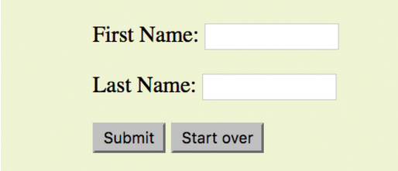
Takeaway question
Create the following registration form using HTML

Slide 27
More Buttons
<input type=“button">
Button: It has no predefined function on its own, unlike submit and reset buttons.
<input type="image">
Image: A graphical submit button. Displays an image defined by the src attribute. The alt attribute displays if the image src is missing.
<button>…</button>
The button element is a flexible element for creating custom buttons similar to those created with the input element.
The content of the button element (text and/or images) is what gets displayed on the button.

Slide 28
Radio and Checkbox Buttons
Both checkbox and radio buttons make it simple for users to choose from a number of provided options.
A form control made up of a collection of radio buttons is appropriate when only one option from the group is permitted.
when the selections are mutually exclusive (such as “Yes or No)
When checkboxes are grouped together, however, it is possible to select as many or as few from the group as desired.
This makes them the right choice for lists in which more than one selection is fine.

Slide 29
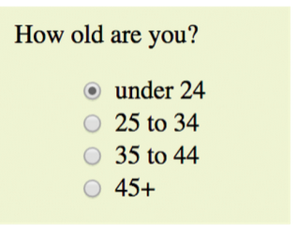
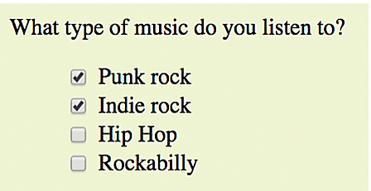
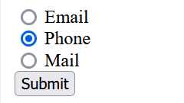
Takeaway exercise
Please select your preferred contact method

Slide 30
Solution
<p>How old are you?</p>
<input type="radio" name="age" value="under24" checked> under 24
<input type="radio" name="age" value="25-34"> 25 to 34
<input type="radio" name="age" value="35-44"> 35 to 44
<input type="radio" name="age" value="over45"> 45+
<p>Please select your preferred contact method</p>
<input type="radio" name=“contact" value=“Email"> Email
<input type="radio" name="contact" value=“Phone“ checked> Phone
<input type="radio" name="contact" value=“Mail"> Mail
<input type=“submit" value=“Submit">
Please select your preferred contact method

Slide 31
Solution
<input type="checkbox" name="genre" value="punk" checked> Punk rock
<input type="checkbox" name="genre" value="indie" checked> Indie rock
<input type="checkbox" name="genre" value="hiphop"> Hip Hop
<input type="checkbox" name="genre" value="rockabilly"> Rockabilly

Slide 32
Ice breaker exercise
Decide whether each of these forms should be sent via the GET or POST method:
A form for accessing your bank account online ________
A form for searching archived articles ________
A form for collecting long essay entries ________

Slide 33
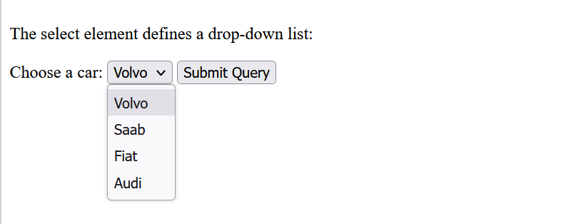
Menus
The <select> element defines a drop-down list:
The <option> elements defines an option that can be selected.
By default, the first item in the drop-down list is selected.
To define a pre-selected option, add the selected attribute to the option
Notes:
markups used to add form controls to a page

Slide 34
The <select> Element (cont’d)
<select id="cars" name="cars"> <option value="volvo">Volvo</option> <option value="saab">Saab</option> <option value="fiat">Fiat</option> <option value="audi">Audi</option> </select>
To define a pre-selected option, add the selected attribute to the option:
<option value="fiat" selected>Fiat</option>
Use the size attribute to specify the number of visible values:
<select id="cars" name="cars" size="3">
Notes:
Use the multiple attribute to allow the user to select more than one value:
<select id="cars" name="cars" size="4" multiple>

Slide 35
Takeaway question
Create a select menu element with the option to choose from
The Cure,
Cocteau Twins,
Tears for Fears,
The Smiths
Make the number of visible values in the menu “2”

Slide 36
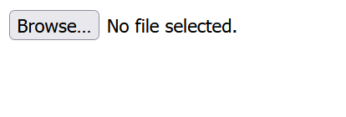
File Selection Control
<input type="file"> File selection field
Web forms can collect more than just data.
A file control lets the user select a file.
The accept attribute defines the types of files that the control can select (audio, video, image, or some other format identified by its media type).
Adding the multiple attribute allows multiple files to be selected for upload.

Slide 37


Date and Time Controls
<input type="date"> date input control
A control for entering a date (year, month, and day, with no time). Opens a date picker.
<input type="time"> Time input control
A control for entering a time value with no time zone.
<input type="month"> specifies a month in a year
A control for entering a month and year, with no time zone.
<input type="week"> specifies a particular week in a year
A control for entering a date consisting of a week-year number and a week number with no time zone.
Notes:
<input type="week" name="name" value="2017-W2">

Slide 38
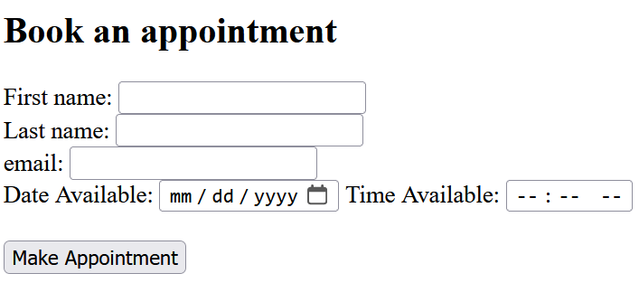
Takeaway question
Write the appropriate markup for the following form

Slide 39


Numerical Inputs
Number: A control for entering a number. Displays a spinner and adds default validation.
<input type=“number">
Range: A control for entering a number whose exact value is not important. The range input is typically displayed as a slider. Used in conjunction min and max to define the range of acceptable values.
<input type="range">

Slide 40
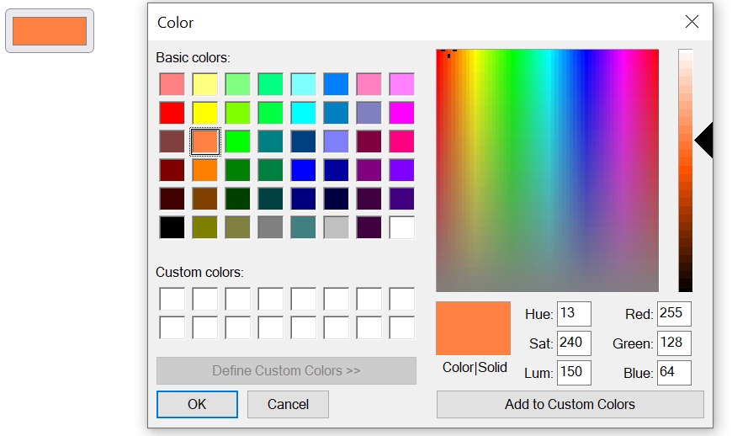
Color Selector
Color: A control for specifying a color; opening a color picker when active in supporting browsers.
<input type="color">

Slide 41
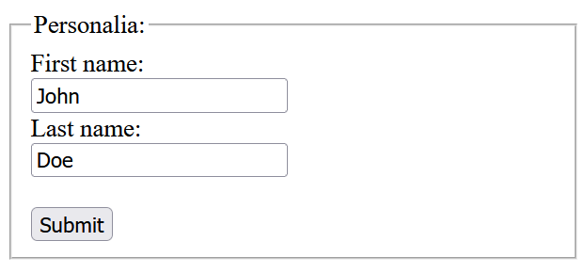
Form Accessibility Features
It is essential to consider how users without the benefit of visual browsers will be able to navigate through your web forms.
The label, fieldset, and legend form elements improve accessibility by making the semantic connections between the components of a form clear.
<label>…</label> Attaches information to form controls
<fieldset>…</fieldset> Groups related controls and labels
<legend>…</legend> Assigns a caption to a fieldset
Legend
Label

Slide 42
The <label> Element
How can you associate a form control with its label?
using the for attribute on all <label> elements, which takes the id of the form control with which it is associated as its value
The <label> element defines a label for several form elements.
It helps users who have difficulty clicking on very small regions, such as radio buttons or checkboxes (when the user clicks the text within the <label> element, it toggles the radio button/checkbox)
<label for="username">Login account</label>
<input type="text" name="login" id="username">

Slide 43
<fieldset> and <legend> Elements
The <fieldset> element is used to group related data in a form.
The <legend> element defines a caption for the <fieldset> element
<form action="/action_page.php">
<fieldset>
<legend>Personalia:</legend>
<label for="fname">First name:</label><br>
<input type="text" id="fname" name="fname" value="John"><br>
<label for="lname">Last name:</label><br>
<input type="text" id="lname" name="lname" value="Doe"><br><br>
<input type="submit" value="Submit">
</fieldset>
</form>

Slide 44
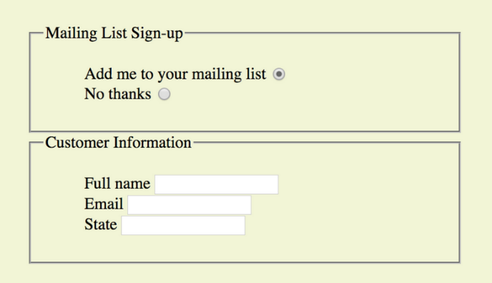
Takeaway exercise
Create a simple HTML form, on completion, the page should look like following

Slide 45
Generic Elements (div and span)
The div element indicates a division of content, and
span indicates a word or phrase for which no text-level element currently exists.

Slide 46
<div> Element
The <div> tag is used as a container for HTML elements
The div element is used to create a logical grouping of elements on a page.
It indicates that these elements belong together in some sort of conceptual unit
Any sort of content can be put inside the <div> tag
As a container, the <div> element does not inherently represent anything.
It’s used to group content so it can be easily styled using css
Notes:
The <div> tag defines a division or a section in an HTML document.
Example: personal website can have an introduction, different sections for discussing different interests (photography, web development etc), hobbies, educational background and finally contact information

Slide 47
<Span> Element
A span offers the same benefits as the div element, except it is used for phrase elements
Because spans are inline elements, they can only contain text and other inline elements
You cannot put headings, lists, div, and so on, in a span
In this example, each telephone number is marked up as a span and classified as “tel”:
<ul>
<li>Abebe: <span class="tel">0114898989</span></li>
<li>John: <span class="tel">0112710945</span></li>
<li>Lemma: <span class="tel">0112106390</span></li>
<li>Zenebech: <span class="tel">0112221987</span></li>
</ul>
Notes:
There is no telephone element, but we can use a span to give meaning to telephone numbers
the classified spans add meaning to what otherwise might be a random string of digits

Slide 48
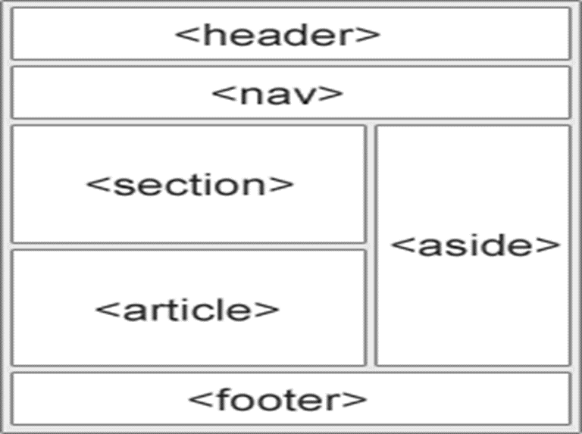
HTML section elements
Prior to HTML5, there was no way to group elements into larger parts other than wrapping them in a generic division (div) element.
HTML5 introduced new elements that give semantic meaning to sections of a typical web page or application, including
main
sections (section),
articles (article),
navigation (nav),
tangentially related content (aside),
headers (header), and
footers (footer)

Slide 49
Semantic sectioning elements
HTML has different semantic elements that define the different parts of a web page:
<main> - Defines primary content area of page or app
<header> - Defines a header for a document or a section
<nav> - Defines a set of navigation links
<section> - Defines a section in a document
<article> - Defines an independent, self-contained content
<aside> - Defines content aside from the content (like a sidebar)
<footer> - Defines a footer for a document or a section

Slide 50
END OF CHAPTER THREE

